Slide 1
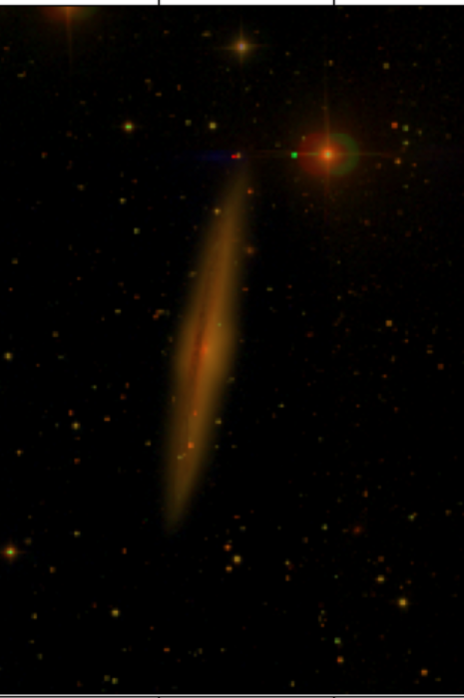



Aspera Space Mission Science Targets and Analysis
Alondra Cardona
Dr. Carlos J. Vargas
2024 AZSGC Symposium

Slide 2
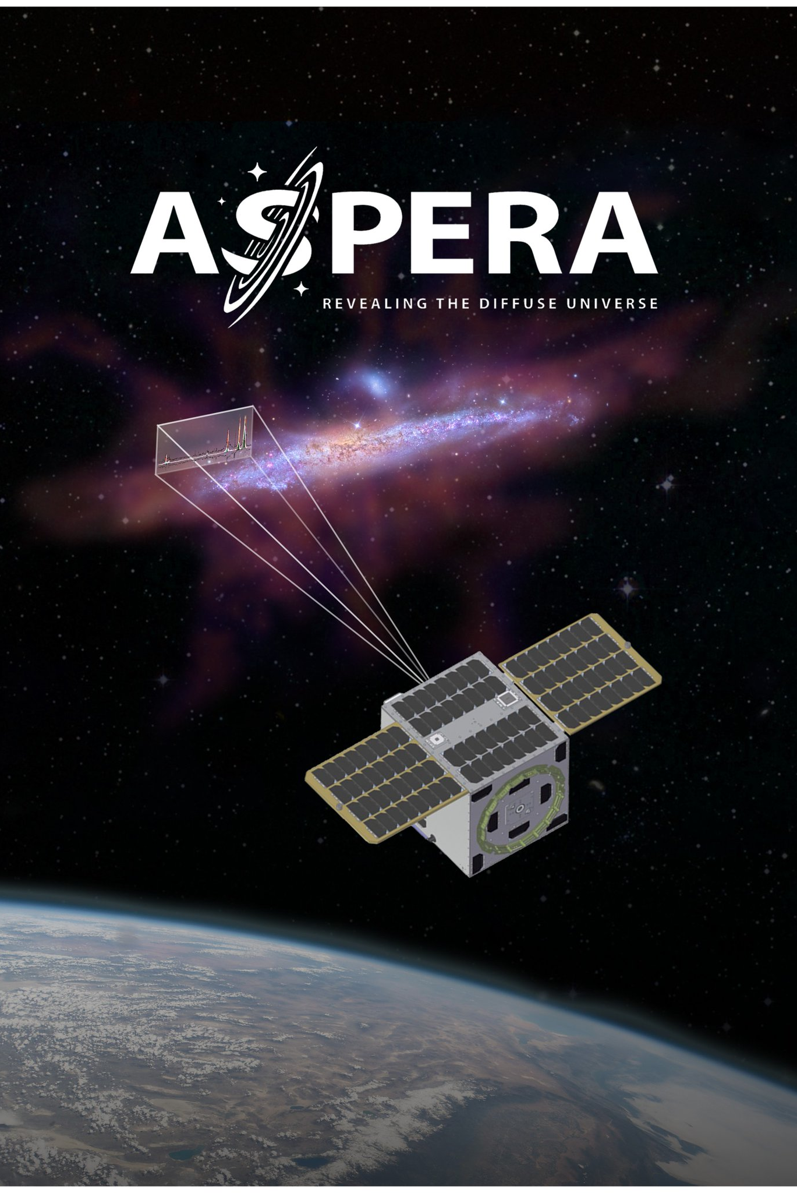

What is Aspera?
Small satellite mission lead by the UofA’s Steward Observatory, funded by the NASA Astrophysics Pioneers Program in 2021
Extreme-UV spectroscopic detections of $O_{VI}$ emission line from the circumgalactic medium
Inspired by the Far-Ultraviolet Spectrographic Explorer (FUSE) launched in 1999
Source: https://www.carlosjvargas.com/research-v2

Slide 3
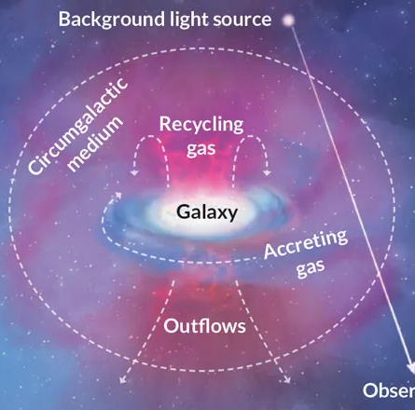
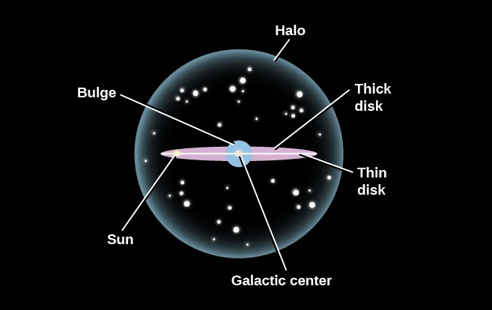
The Circumgalactic medium (CGM)
Galactic halo = CGM
Originally studied through features in quasar spectra, absorption features
Abundant in oxygen and carbon ions
Has different temperature phases
This Photo by Unknown Author is licensed under CC BY
Source: J. Tumlinson, M.S. Peeples and J.K. Werk/Annual Review of Astronomy and Astrophysics 2017; M.S. Peeples/Nature 2015
Source: Sources: J. Tumlinson, M.S. Peeples and J.K. Werk/Annual Review of Astronomy and Astrophysics 2017; M.S. Peeples/Nature 2015

Slide 4
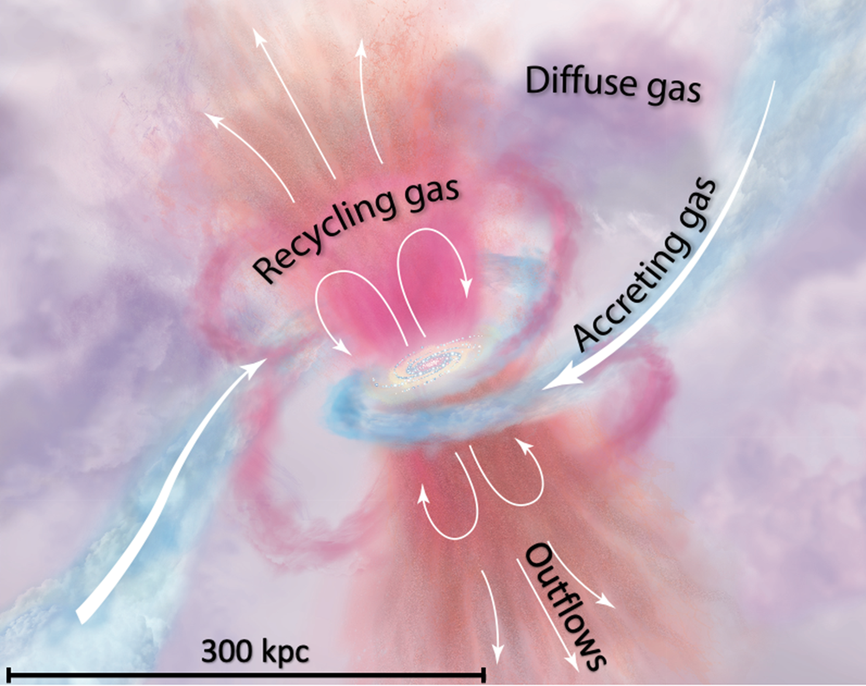
The Circumgalactic medium (CGM)
First to detect and map ultraviolet emission from the warm-hot phase of the Circumgalactic Medium (CGM)
CGM gas beyond the cold neutral phase is severely understudied
Aspera’s look into the warm-hot phase will provide better understanding of diffuse gas dynamics crucial for baryonic matter recycling, star formation, and galactic evolution
Tumlinson et al. (2017)

Slide 5
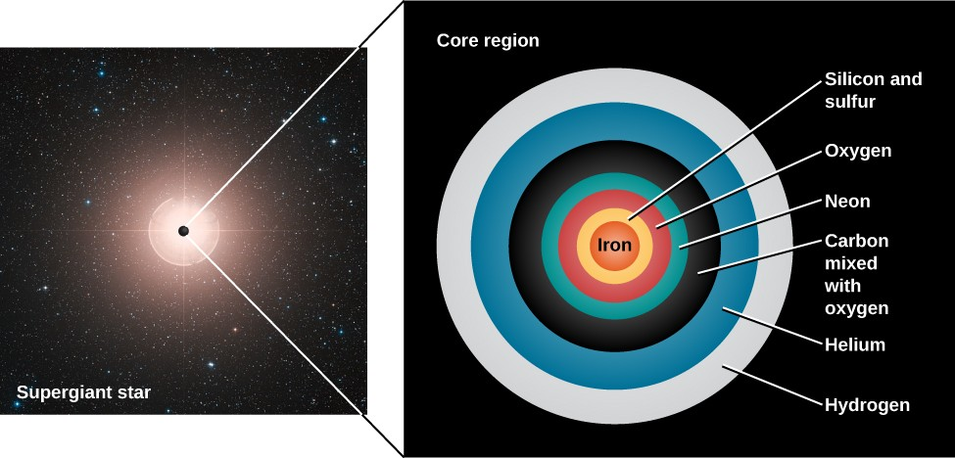
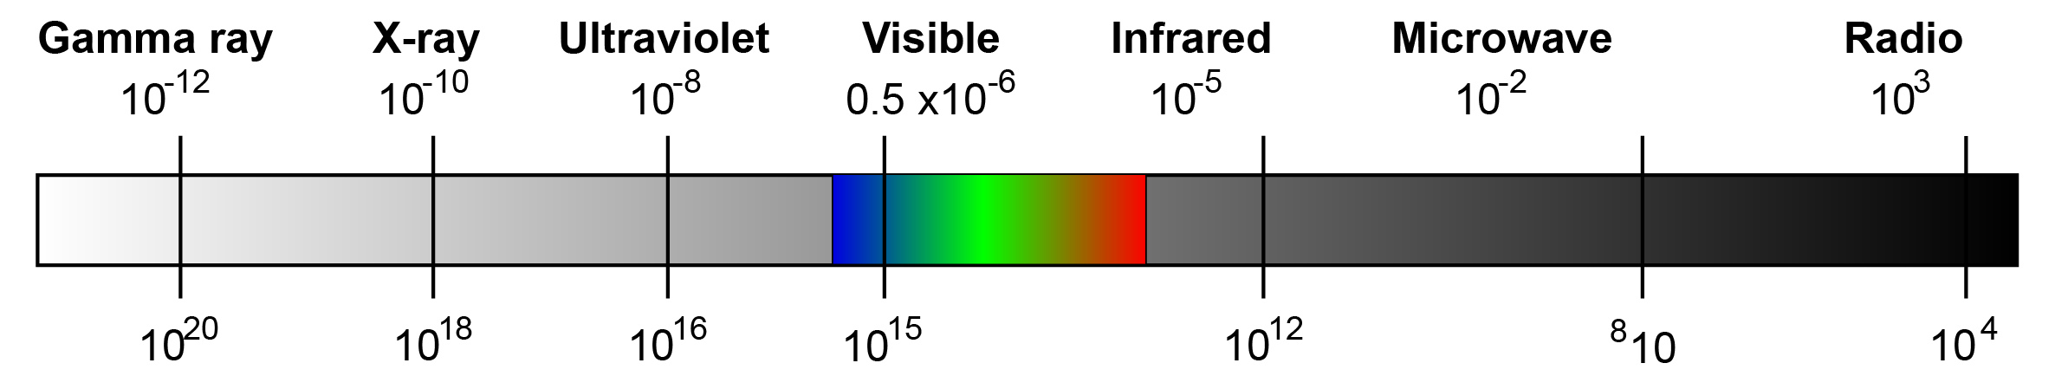
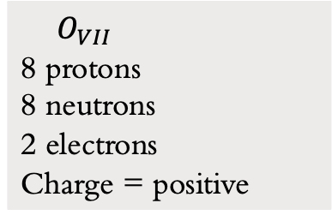

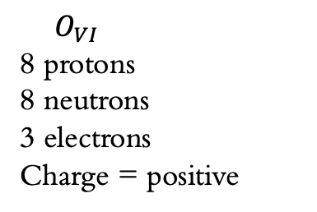
Why OXYGEN IONS?
O
8 protons
8 neutrons
8 electrons
Charge = neutral
$O_{VII}$
8 protons
8 neutrons
2 electrons
Charge = positive
$O_{VI}$
8 protons
8 neutrons
3 electrons
Charge = positive
$λ$=1032Å=1.032$x{10}^{−7}m$
Source: https://physicsigcse.wordpress.com/2016/05/06/3-11-identify-the-order-of-the-electromagnetic-spectrum-in-terms-of-decreasing-wavelength-and-increasing-frequency-including-the-colours-of-the-visible-spectrum/
21
21
21
21
This Photo by Unknown Author is licensed under CC BY

Slide 6
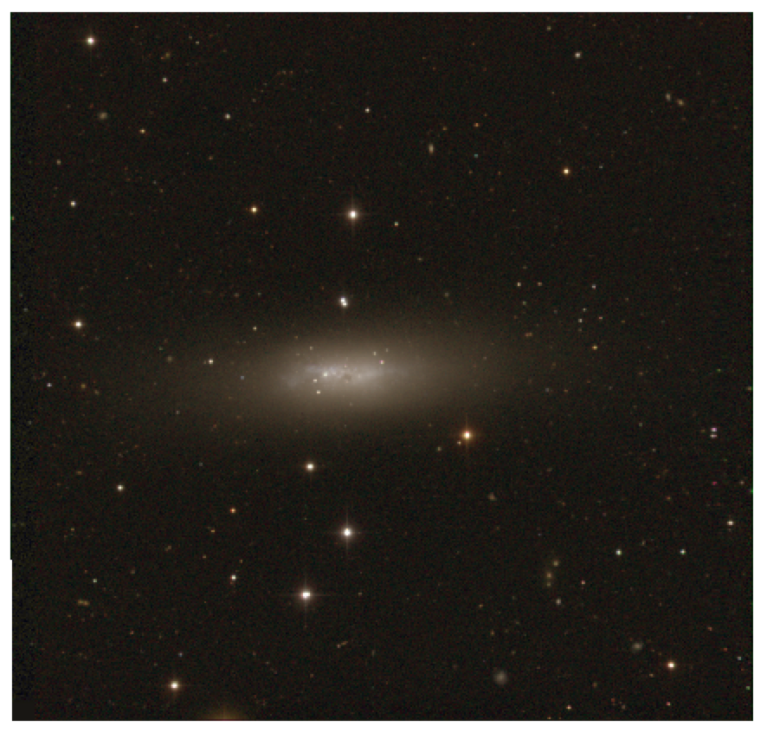
Selecting Suitable Targets
Currently considering 21 different targets (will observe up to 10 during its 9-month lifetime)
Target criteria:
* i>78degree to ensure clear view of galactic halo (edge-on)
* angular size fits into spectrograph field of view
* star formation rates indicative of sufficient elemental reservoirs
* recessional velocities within detectable wavelength redshifts
* few nearby galaxies to avoid confusion, and no AGN or starburst galaxies to minimize complex fluid dynamics
* dust extinction < 1 mag

Slide 7

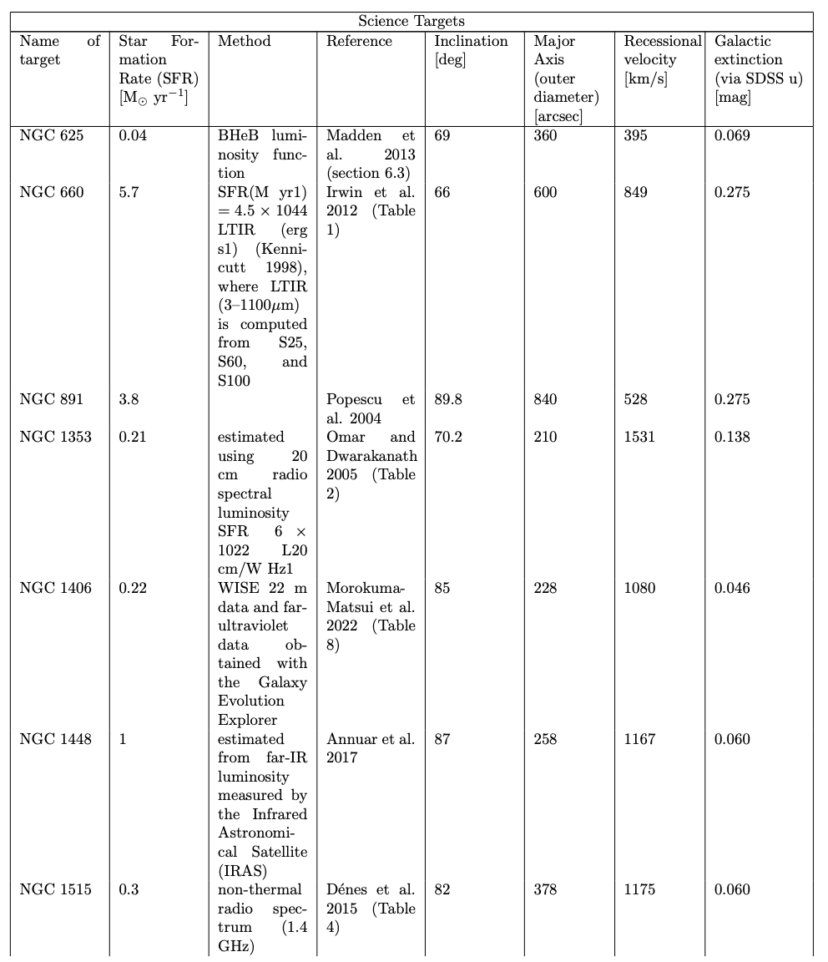
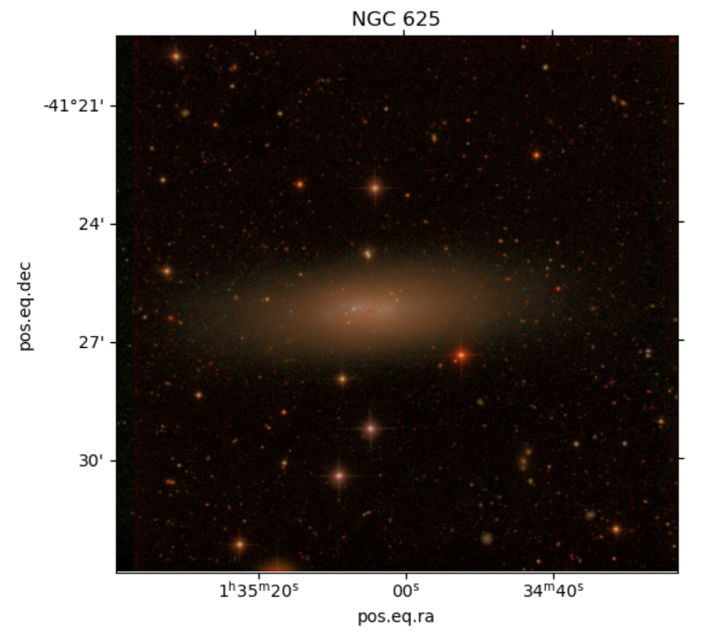
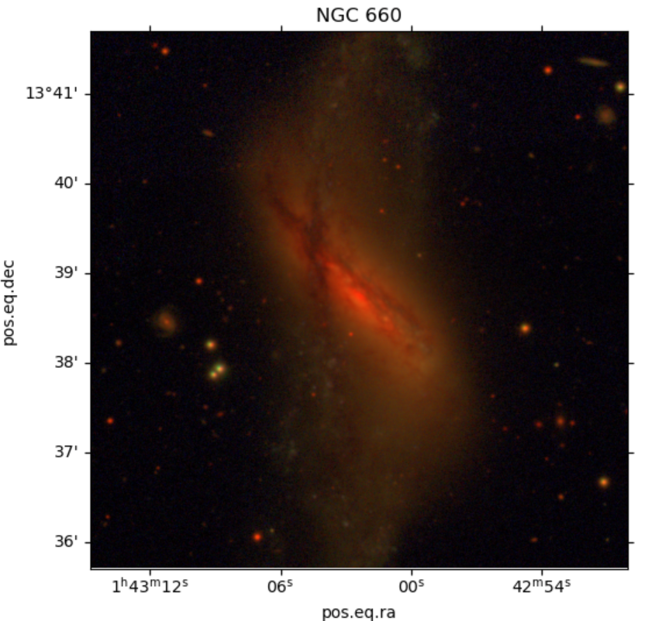
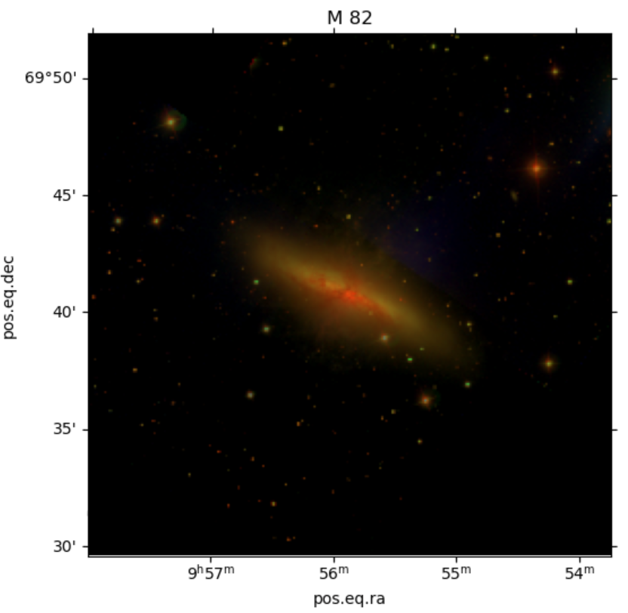
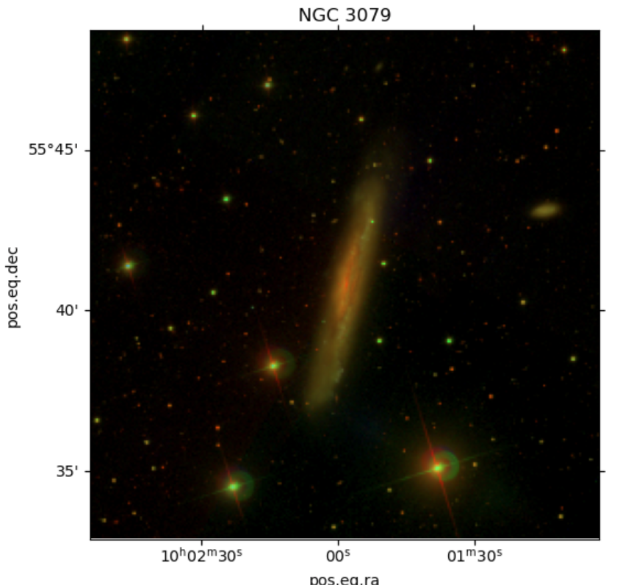
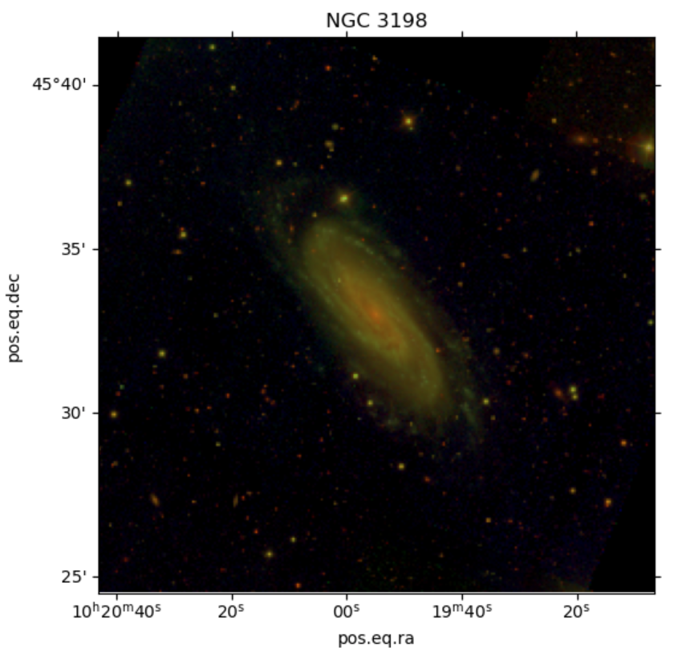
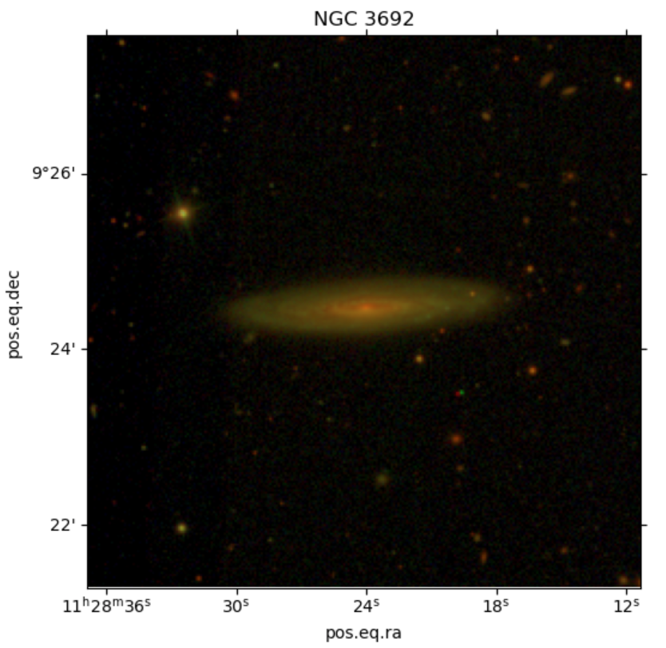
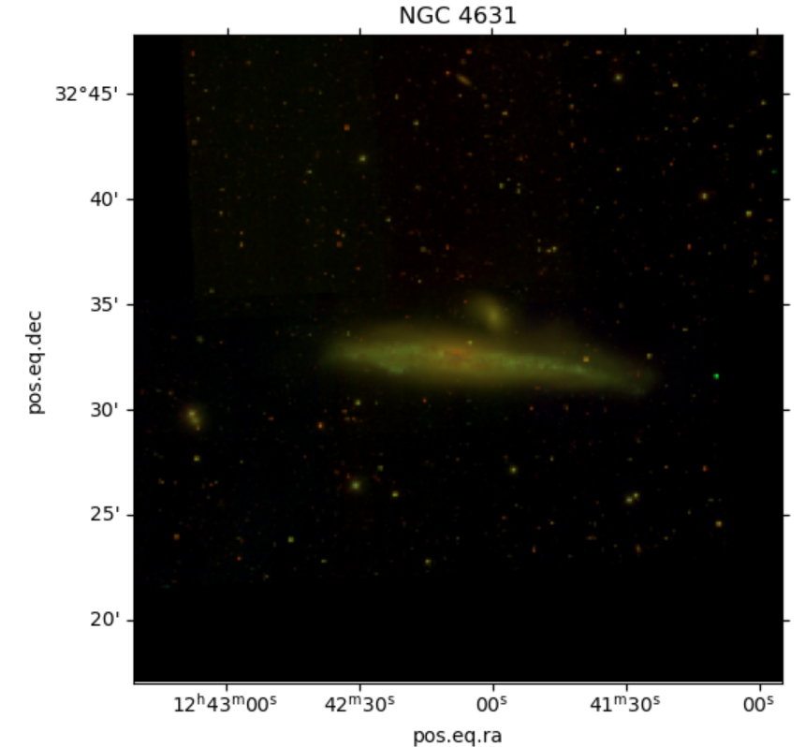
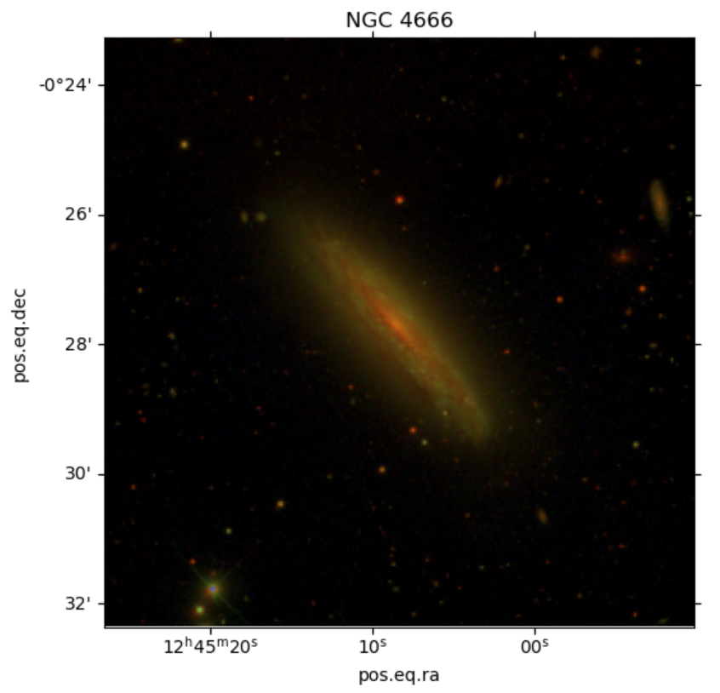
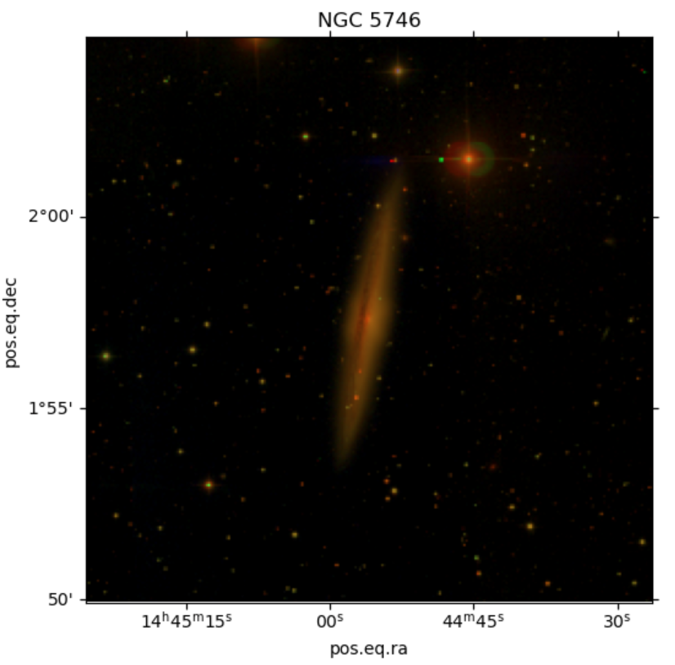
Target Analysis

Slide 8
Acknowledgements
Dr. Carlos Vargas, Research Advisor and Principal Investigator of Aspera
Elijah Garcia, Laboratory Manager
University of Arizona Steward Observatory
Arizona Space Grant Consortium

Slide 9

Thank you!

